Slide 1
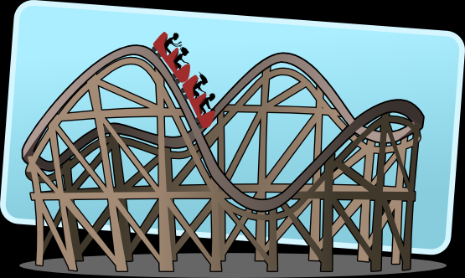
Roller Coaster

Slide 4
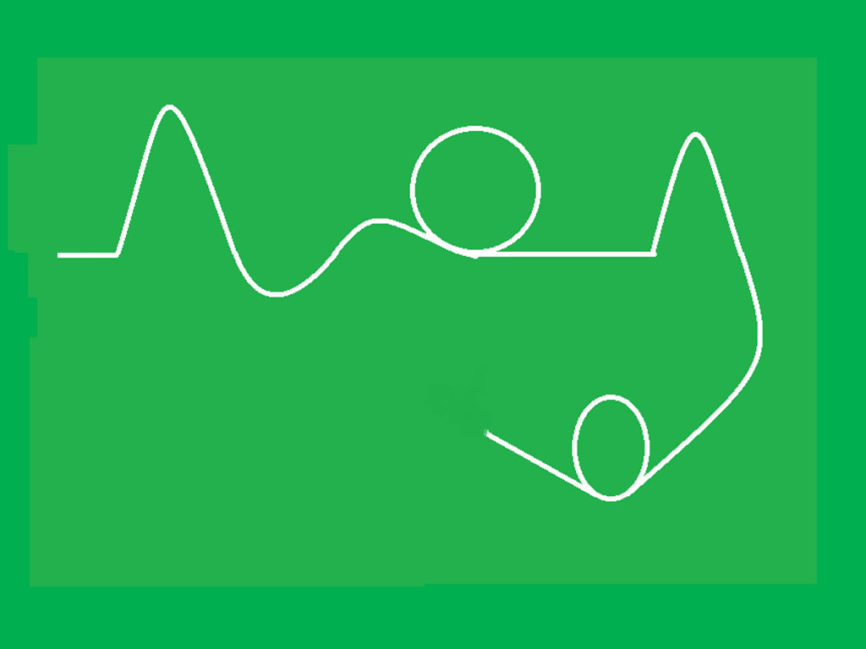

Slide 6
Fast

Slide 7
slow

Slide 8
Warp speed

Slide 9
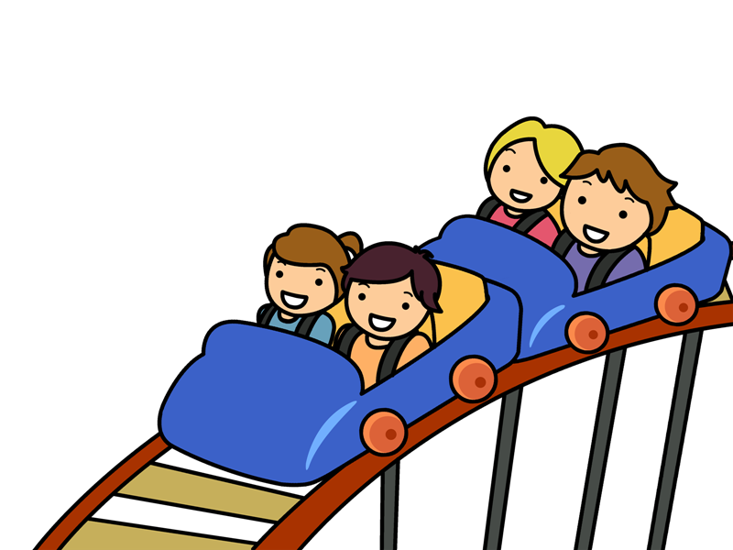
Your turn! Raise your hand to come up to the board and draw your own roller coaster for the class to “ride”.

